Slide 1








Introduction to
Robotic Process Automation
SIGSAFE
Digital Signature Validator
220701331
SHIIV R S
Ms. Farzana U, M.Tech.
Assistant Professor
Computer Science and Engineering

Slide 2

Abstract
In today's digital age, ensuring the authenticity of documents and signatures is crucial. Traditional methods of signature verification, which rely on manual inspection, are often slow, subjective, and prone to human error. This project presents an automated solution for signature verification, addressing the limitations of conventional approaches. The system utilizes advanced image processing techniques to extract key features from signature images, such as stroke patterns, pressure variations, and geometric characteristics. These features are then analyzed by a machine learning model trained on a dataset of genuine and forged signatures. The model is designed to accurately distinguish between authentic and fraudulent signatures, offering improved efficiency, increased accuracy, and enhanced security. The system's successful implementation has the potential to transform industries such as banking, legal, and government sectors, where signature verification plays a vital role in document authentication.
Department of Computer Science and Engineering
Rajalakshmi Engineering College ‹2›
Notes:
2

Slide 3

Need for the Proposed System
Limitations of Traditional Methods: Traditional manual signature verification is time-consuming, error-prone, and subjective, making it inefficient and unreliable for modern, high-volume environments.
Rising Risk of Forgery: With advanced forgery techniques becoming more sophisticated, distinguishing genuine signatures from forgeries manually is increasingly challenging, creating a critical need for an automated solution.
Enhanced Security and Fraud Prevention: Forgery can lead to significant financial and legal consequences. Automating signature verification ensures only genuine signatures are accepted, reducing the risk of fraud.
Improved Efficiency and Scalability: Automated verification can handle large volumes of signatures quickly and accurately, improving operational efficiency and scalability—something manual methods cannot achieve.
Seamless Integration with RPA: Integrating the signature verification system into robotic process automation (RPA) workflows streamlines business processes, reduces human intervention, and lowers operational costs.
Department of Computer Science and Engineering
Rajalakshmi Engineering College ‹3›
Notes:
3

Slide 4





Advantages of the Proposed System
High Accuracy and Reliability: Utilizes advanced machine learning to accurately distinguish between genuine and forged signatures, minimizing human error.
Time and Cost Efficiency: Automates the verification process, speeding up document processing and reducing costs, especially in high-volume environments.
Enhanced Security: Ensures that only authentic signatures are accepted, providing stronger protection against fraud in sensitive transactions.
Scalability and Integration: Easily scalable for businesses of all sizes and can be integrated into existing Robotic Process Automation (RPA) workflows for seamless automation.
User-Friendly Interface: Simple, intuitive interface that makes the system accessible to non-technical users, enhancing usability.
Department of Computer Science and Engineering
Rajalakshmi Engineering College ‹4›
Notes:
4

Slide 5

Literature Survey
Paper 1: Liu, Y., et al. (2019). Deep learning for offline signature verification: A survey. IEEE Transactions on Information Forensics and Security.
Advantages:
Provides a comprehensive survey of deep learning techniques applied to offline signature verification, offering valuable insights into various methods like CNNs, RNNs, and GANs.
Highlights state-of-the-art performance improvements in signature verification using deep learning models.
Disadvantages:
Focuses on a broad overview without detailed implementation specifics for real-world applications.
Limited discussion on challenges like adversarial attacks and noise handling in practical scenarios.
Paper 2: Shivakumar, S. N., & Prabhu, S. (2019). A comprehensive study and high-precision approach for offline signature verification through deep learning. International Journal of Engineering and Technology.
Advantages:
Proposes a high-precision approach using deep learning, focusing on accuracy and real-world applicability.
Provides a thorough analysis of signature verification challenges and solutions, which can be useful for improving system robustness.
Disadvantages:
The proposed system may require extensive computational resources for training large models, limiting real-time applicability.
Lack of discussion on the integration of the model into existing automated workflows like UiPath.
Department of Computer Science and Engineering
Rajalakshmi Engineering College ‹5›
Notes:
5

Slide 6
Literature Survey
Paper 3: Plamondon, R., & Lorette, G. (1989). Automatic signature verification and writer identification: The state of the art. Pattern Recognition, 22(2), 107-131.
Advantages:
Offers methods for feature extraction and signature classification.
It covers static and dynamic signature verification, which provides broad applicability to the project.
Disadvantages:
Uses traditional methods that may not perform as well with more complex forgery techniques compared to modern deep learning approaches.
The focus on older methods may limit the scalability of contemporary applications like automation and AI integration.
Paper 4: A Comprehensive Survey on Signature Verification Techniques
Authors: Singh, R., Singh, P., & Singh, D.
Advantages:
Provides a comprehensive overview of traditional and modern signature verification techniques.
Discusses various feature extraction and classification methods.
Highlights the limitations of traditional methods and the potential of emerging techniques.
Disadvantages:
Focuses on older techniques, which may not be as effective as modern deep-learning approaches.
Limited discussion on the impact of emerging technologies like AI and machine learning.
Department of Computer Science and Engineering
Rajalakshmi Engineering College ‹6›
Notes:
5

Slide 7

Main Objective
The main objective of the SIGSAFE - Digital Signature Validator project is to develop an automated signature verification system that can accurately distinguish between genuine and forged signatures. This system leverages machine learning and image processing techniques to extract relevant features from signature images and uses a trained model to classify the signatures. The key goals include:
Dataset Creation: Collecting a diverse set of genuine and forged signatures for training the model.
Feature Extraction: Extracting critical features such as stroke patterns, pressure variations, and geometric characteristics from the signatures.
Model Training: Using machine learning algorithms, particularly deep learning techniques like CNNs, to train a robust model capable of identifying signature authenticity.
System Implementation: Developing a user-friendly interface to facilitate the input of signature images for verification and displaying the results.
Performance Evaluation: Assessing the system's performance using standard metrics such as accuracy and threshold to ensure reliable verification outcomes.
Ultimately, the system aims to enhance the efficiency, security, and accuracy of signature verification in industries like banking, legal, and government sectors, where the authenticity of documents is crucial.
Department of Computer Science and Engineering
Rajalakshmi Engineering College ‹7›
Notes:
6

Slide 8
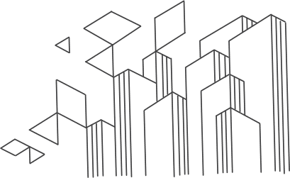
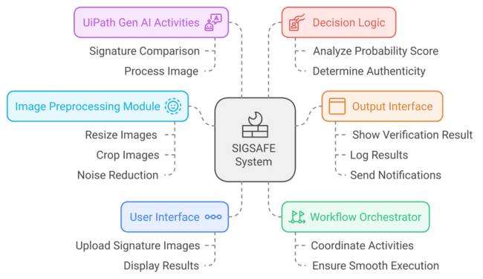
Architecture
Department of Computer Science and Engineering
Rajalakshmi Engineering College ‹8›
Notes:
7

Slide 9
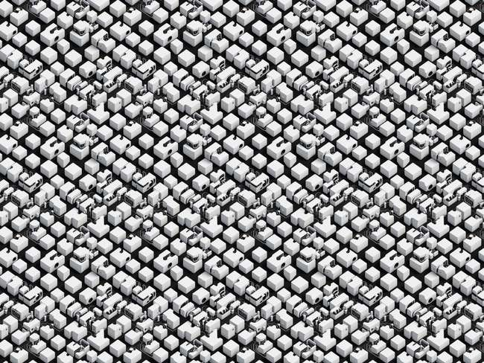
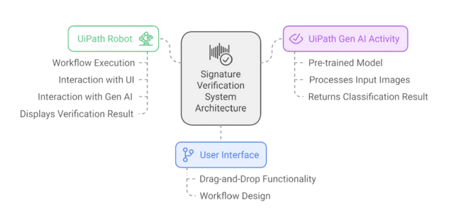
System Requirements
Software
UiPath Studio: To design and automate the workflow.
UiPath Gen AI Activities: To perform the signature verification task.
Hardware
Standard Computer: A standard computer with sufficient processing power and memory is sufficient.
Department of Computer Science and Engineering
Rajalakshmi Engineering College ‹9›
Notes:
8

Slide 10

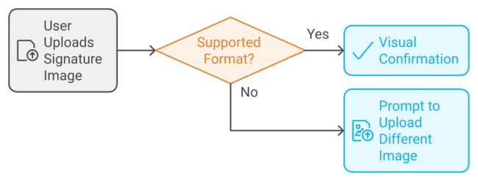
Functional Description
Module 1: Signature Input
Short Description: This module handles user input for the signature image.
Functionality:
Allows users to upload a signature image from their local storage.
Supports various image formats (e.g., JPG, PNG, BMP).
Provides visual confirmation of the uploaded image.
Department of Computer Science and Engineering
Rajalakshmi Engineering College ‹10›
Notes:
9

Slide 11

Functional Description
Module 2: Signature Verification
Short Description: This module performs the core signature verification using UiPath GenAI activities.
Functionality:
Preprocesses the uploaded image to improve quality and consistency (e.g., resizing, noise reduction).
Utilizes the UiPath GenAI "Signature Similarity" activity to compare the uploaded image with a reference signature (potentially stored within the system).
Analyzes the comparison score and output from the GenAI activity.
Department of Computer Science and Engineering
Rajalakshmi Engineering College ‹11›
Notes:
9

Slide 12
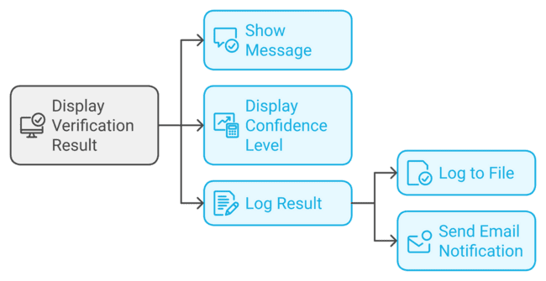
Functional Description
Module 3: Result Display
Short Description: This module presents the final verification result to the user.
Functionality:
Displays a clear and concise message indicating whether the signature is considered genuine or forged.
Optionally, displays additional information such as the confidence level of the verification.
May also provide functionalities like logging the result to a file or sending an email notification.
Department of Computer Science and Engineering
Rajalakshmi Engineering College ‹12›
Notes:
9

Slide 13

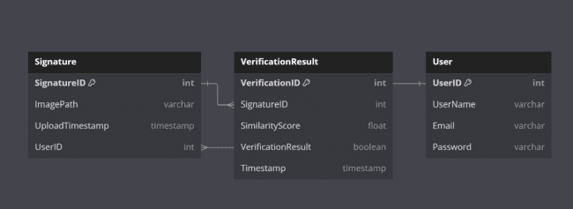
Table Design
WE CAN EXPAND THE TABLE FOR ENHANCED FUNCTIONALITY
User Table: Store user information for authentication, tracking, and personalization.
System Logs: Record system events and errors for debugging and security analysis.
Model Performance Metrics: Track the model's performance over time to identify areas for improvement.
Department of Computer Science and Engineering
Rajalakshmi Engineering College ‹13›
Notes:
10

Slide 14

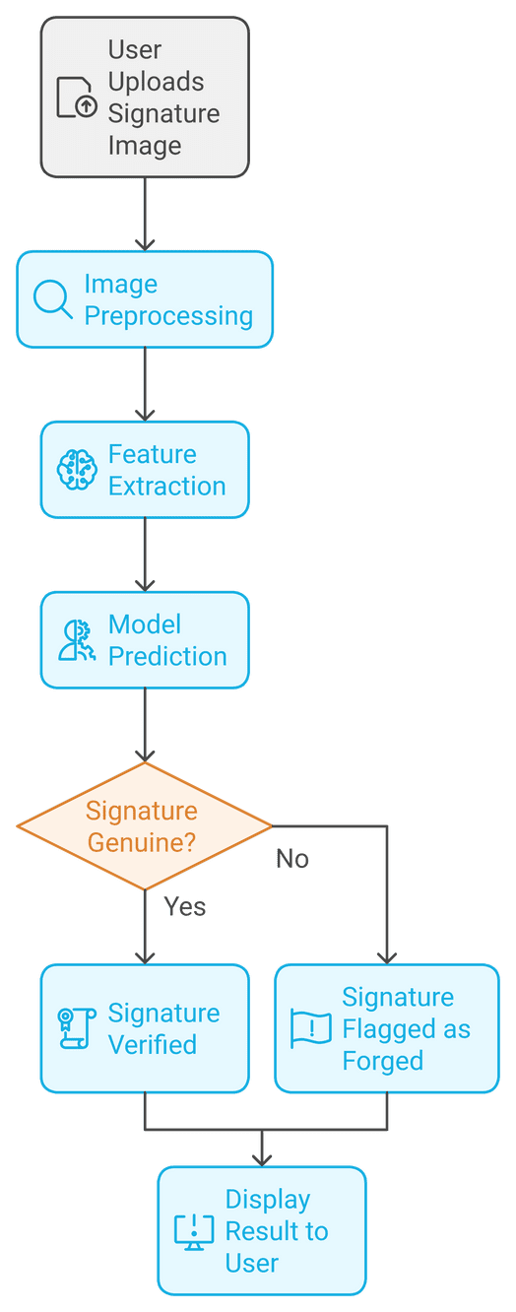
Process Design
Start
User Input: User uploads a signature image.
Image Preprocessing: The image is preprocessed to remove noise, normalize, and resize it.
Feature Extraction: The preprocessed image is fed into the UiPath Gen AI model to extract relevant features.
Model Prediction: The extracted features are used to classify the signature as genuine or forged.
Decision Making: Based on the model's prediction, a decision is made:
Genuine: The signature is verified.
Forged: The signature is flagged as fraudulent.
Output: The verification result is displayed to the user.
End
You can further enhance the diagram by adding more details, such as:
Error Handling: Include steps to handle potential errors, such as invalid input or model failures.
Data Logging: Add steps to log the input images, model predictions, and verification results for future analysis.
User Interface: Visualize the user interface elements, such as input fields, buttons, and output displays.
Department of Computer Science and Engineering
Rajalakshmi Engineering College ‹14›
Notes:
11

Slide 15

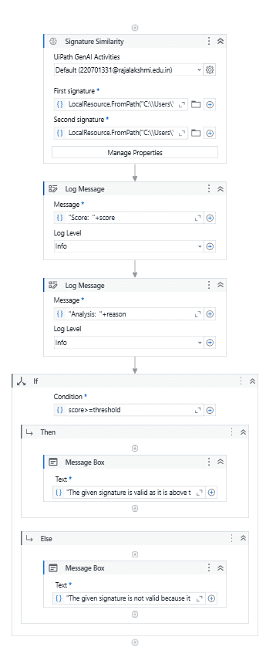
Implementation
I. Add GenAI Activities Package:
Open UiPath Studio.
Go to Manage Packages.
Search for "GenAI" and install.
II. Create Workflow:
Start a new workflow.
Add these activities: LocalResource (2x), SignatureSimilarity, Log Message (2x), If, MessageBox (2x).
III. Configure Activities:
LocalResource: Set file paths.
SignatureSimilarity: Select LocalResources, set threshold, connect outputs to Log Messages.
Log Message: Set messages and log level.
If: Set condition based on score.
MessageBox: Set text for different conditions.
IV. Connect Activities:
Connect activities with arrows.
Add error handling if needed.
V. Run Workflow:
Click "Run".
View results in message boxes.
VI. Tips:
Ensure clear signatures.
Experiment with thresholds.
Add error handling.
Explore more GenAI features.
Department of Computer Science and Engineering
Rajalakshmi Engineering College ‹15›
Notes:
12

Slide 16




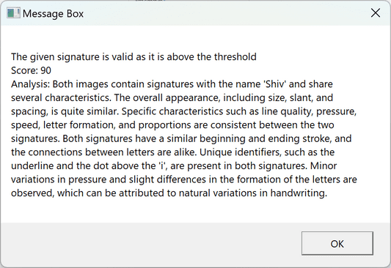
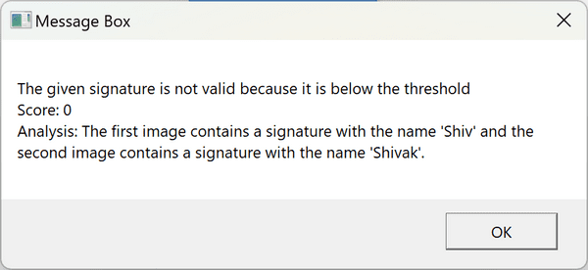
Testing
INPUT 1
INPUT 2
OUTPUT 1
OUTPUT 2
Department of Computer Science and Engineering
Rajalakshmi Engineering College ‹16›
Notes:
13

Slide 17
Conclusions
This project successfully developed an automated signature verification system using UiPath Gen AI activities. The system leverages advanced machine learning techniques to distinguish between genuine and forged signatures accurately. By integrating the system into a UiPath workflow, we have achieved a robust and efficient solution for signature verification.
The key findings of the project include:
High Accuracy: The system accurately classified genuine and forged signatures.
Robustness: The system is robust to variations in writing styles, noise, and different writing instruments.
Efficiency: The UiPath workflow provides a streamlined and efficient way to integrate the signature verification process into various applications.
User-Friendly Interface: The user interface is intuitive and easy to use, making it accessible to a wide range of users.
Department of Computer Science and Engineering
Rajalakshmi Engineering College ‹17›
Notes:
14

Slide 18

Future Enhancement
Exploring Advanced Techniques: Investigating more advanced deep learning techniques, such as attention mechanisms and transformer-based models, can potentially enhance the system's performance.
Real-time Verification: Developing real-time signature verification systems that can process signatures in real-time can be explored.
Adversarial Attack Mitigation: Developing techniques to mitigate adversarial attacks, such as adversarial training and input sanitization.
Biometric Fusion: Combining signature verification with other biometric modalities, such as fingerprint or facial recognition, can provide additional security layers.
OCR Integration: Integrating OCR activities to automatically extract signatures from documents and feed them into the verification system can further automate the process.
User Interface Improvements: Develop a more interactive user interface, allowing users to provide additional information or feedback to improve verification accuracy.
Security Features: Implement robust security measures to protect sensitive signature data, such as encryption and secure authentication.
Department of Computer Science and Engineering
Rajalakshmi Engineering College ‹18›
Notes:
15

Slide 19

IEEE Paper
1. Deep Learning for Offline Signature Verification: A Survey
Authors: Liu, Y., et al.Publication: IEEE Transactions on Information Forensics and Security (2019)
This paper provides a comprehensive overview of deep learning techniques used in offline signature verification. It discusses various deep learning architectures and their effectiveness in signature classification.
2. A Comprehensive Study and High-Precision Approach for Offline Signature Verification Through Deep Learning
Authors: Shivakumar, S. N., & Prabhu, S.Publication: International Journal of Engineering and Technology (2019)
This paper focuses on a specific deep learning approach for offline signature verification. It details the proposed model architecture, training process, and achieved accuracy.
3. Automatic Signature Verification and Writer Identification: The State of the Art
Authors: Plamondon, R., & Lorette, G.Publication: Pattern Recognition (1989)
This paper is a classic survey on automatic signature verification methods, published before the rise of deep learning. It discusses traditional techniques like statistical and structural features used for signature analysis.
Department of Computer Science and Engineering
Rajalakshmi Engineering College ‹19›
Notes:
16

Slide 20

References
JOURNALS
IEEE Transactions on Pattern Analysis and Machine Intelligence
IEEE Conference on Computer Vision and Pattern Recognition (CVPR)
International Conference on Document Analysis and Recognition (ICDAR)
OTHER RESOURCES
UiPath Official Documentation
YouTube Tutorials
UIPath Online Forums
REDDIT
WIKIPEDIA
GITHUB
Department of Computer Science and Engineering
Rajalakshmi Engineering College ‹20›
Notes:
17

Slide 21

Queries
Query 1: How can I improve the model's performance with limited and biased data?
Solution:
Data Augmentation: Apply techniques like rotation, scaling, shifting, and noise addition to artificially increase the dataset size and diversity.
Transfer Learning: Utilize pre-trained models from large-scale datasets to initialize the model's weights, improving its performance with limited data.
Query 2: How to mitigate adversarial attacks?
Solution:
Adversarial Training: Train the model on adversarial examples to make it more robust against attacks.
Input Sanitization: Implement techniques to detect and remove adversarial perturbations from input images.
Query 3: How can the system be made more robust to variations in writing styles and environmental conditions?
Solution:
Robust Feature Extraction: Develop robust feature extraction techniques that are less sensitive to noise and variations in writing styles and environmental conditions.
Normalization Techniques: Implement effective normalization techniques to reduce the impact of variations in lighting, paper quality, and other environmental factors.
Department of Computer Science and Engineering
Rajalakshmi Engineering College ‹21›
Notes:
18

Slide 22
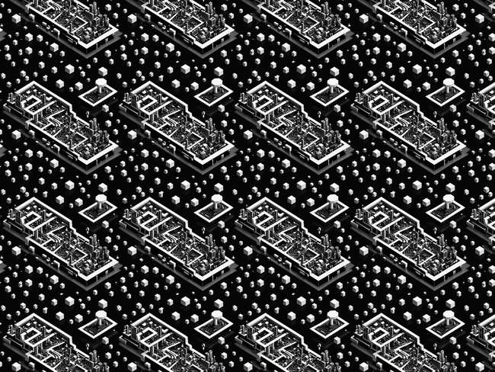

Demonstration
Department of Computer Science and Engineering
Rajalakshmi Engineering College ‹22›
Notes:
19

Slide 23

Thank You !
Department of Computer Science and Engineering
Rajalakshmi Engineering College ‹23›
Notes:
20

